Slide 1



Understanding get() and load()
Chapter 5

Slide 2
Today’s Agenda
Understanding get() and load()
What is get () ?
How get() works ?
What is load() ?
How load() works ?
Why two methods ?
The difference between get() and load() ?

Slide 3
Introduction To Method get( )
Hibernate’s Session interface provides several methods for fetching entities from the database.
The two very popular are get() and load() methods

Slide 4
Introduction To Method get( )
The method get() has multiple overloaded versions but the most common is
public Object get(Class clazz, Serializable id) throws HibernateException
The first argument is the .class file name of the Entity class and the second argument is the id value i.e the primary key identifier which will be used for searching the record in the database

Slide 5
Internal Working Of get( )
This method does the following:
At first it searches in cache and if it finds the object with the requested identifier in cache , then it returns a fully initialized object from the cache.
If the requested identifier is not found in cache , then it hits the database and returns the original object from the database.
If there is no row corresponding to the requested identifier, even in the database then this method will return null.

Slide 6
Introduction To Method load( )
The method load() is also used to fetch a record and it also has multiple overloaded versions but the most common is
public Object load(Class clazz, Serializable id) throws HibernateException
The first argument is the .class file name of the Entity class and the second argument is the id value i.e the primary key identifier which will be used for searching the record in the database

Slide 7
Internal Working Of load( )
This method does the following:
At first it searches in cache and if it finds the object with the requested identifier in cache , then it returns a fully initialized object from the cache.
If the requested identifier is not found in cache , then it returns a proxy object
Proxy means, hibernate will prepare some fake object with given identifier value in the memory without hitting the database
All other properties of this proxy object are left uninitialized and hibernate returns this object

Slide 8
Internal Working Of load( )
Now if later we access other properties of the proxy object then hibernate will hit the database , search the row with the given identifier and retrieve the values.
This behavior is called LAZY LOADING
If object [row] is not found in the database then hibernate will throw an exception called ObjectNotFoundException.,

Slide 9

Roll Up Your Sleeves. . .

Slide 10
load() V/s get()
Database hit
get() method always hits the database if it doesn’t find the object in the cache while load() method may not always hit the database

Slide 11
load() V/s get()
Proxy
get() method never returns a proxy, it either returns null or fully initialized Object, while load() method may return proxy, which is the object with ID but without initializing other properties, which is lazily initialized.

Slide 12
load() V/s get()
Behavior when Object is not found in Session Cache
get() method of Hibernate Session hits the database if the object is not found in cache and if it is not in database too then it returns null , while load() method returns a proxy object if object is not found in the cache .
Moreover when we try to access properties of the object then the ObjectNotFoundException will occur.

Slide 13
Final Conclusion
get() loads the data as soon as it’s called whereas load() returns a proxy object and loads data only when it’s actually required, so load() is better because it support lazy loading.

Slide 14
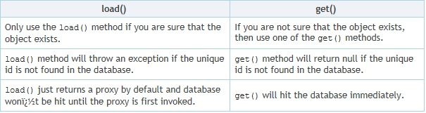
When To Use get() and When To Use load() ?
This means we must use load() when we need to obtain a reference to the object without issuing extra SQL queries, for example, to create a relationship with another object.

Slide 15
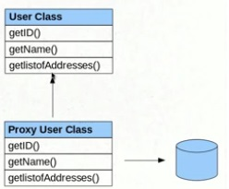
What Is Proxy ?
Proxy means, hibernate will prepare some fake object with given identifier value in the memory without hitting the database.
If we call
session.load(User.class,new Integer(107));
hibernate will create one fake User object
in the memory with id 107,
but remaining properties of
User class will not even be initialized.

